Slide 1

NextStep Science: A Lab AI Assistant
Microsoft Innovation Challenge
Team Members:
Giovanni Yisrael Lopez Garcia
Hansell Augusto Najarro Altan
Isaac Suarez Maldonado
Jose Angel Zavaleta Ruiz
Sabina Ixchel Garcia Mendoza

Slide 2

I
The Problem & Project Goal

Slide 3

The Problem & Project Goal
The Issue
Generic AI systems lack domain-aware safeguards and can provide hazardous scientific suggestions.
Value Proposition
Augmenting reasoning while preventing unsafe or hazardous recommendations.
The Goal
Build an assistant that understands experimental inputs (PDFs, CSVs, Images) to suggest safe, bounded next steps.

Slide 4
II
Core Capabilities & Multimodal Input

Slide 5
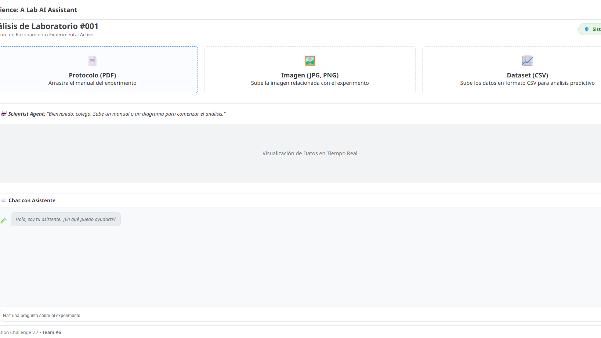
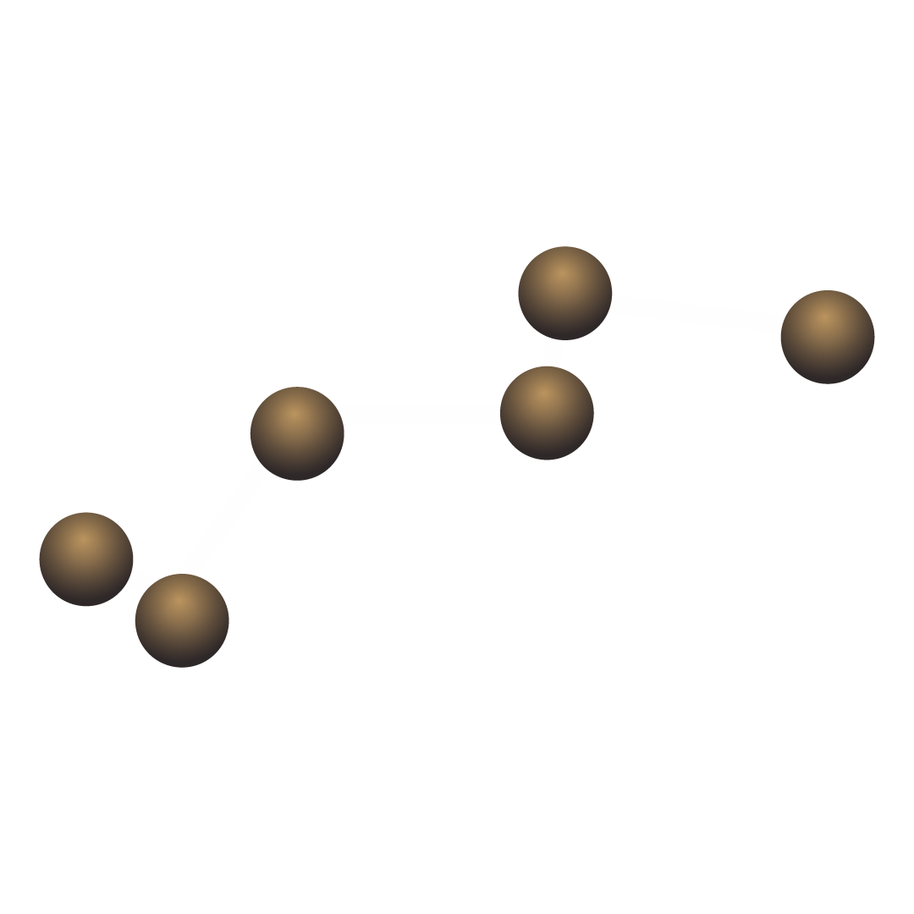
Input Handling
Supports PDF protocols, CSV datasets, and image-based experimental setups.

Slide 6
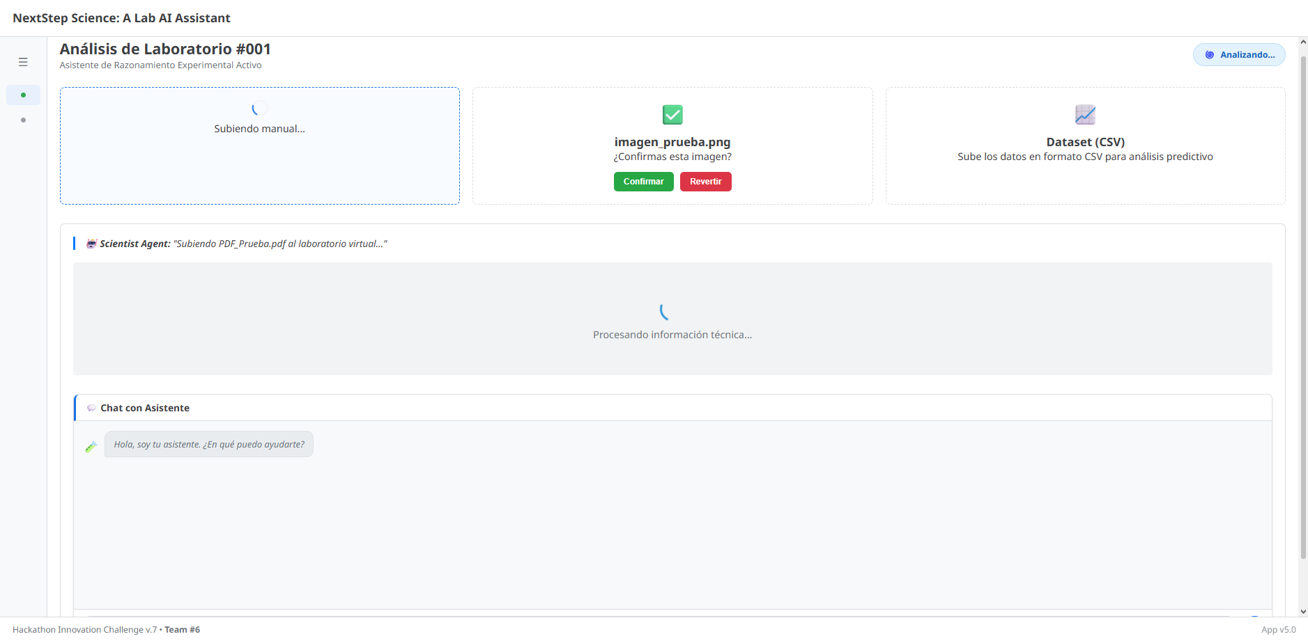
Processing Power
Automated extraction of experimental content and maintenance of conversational session memory.

Slide 7
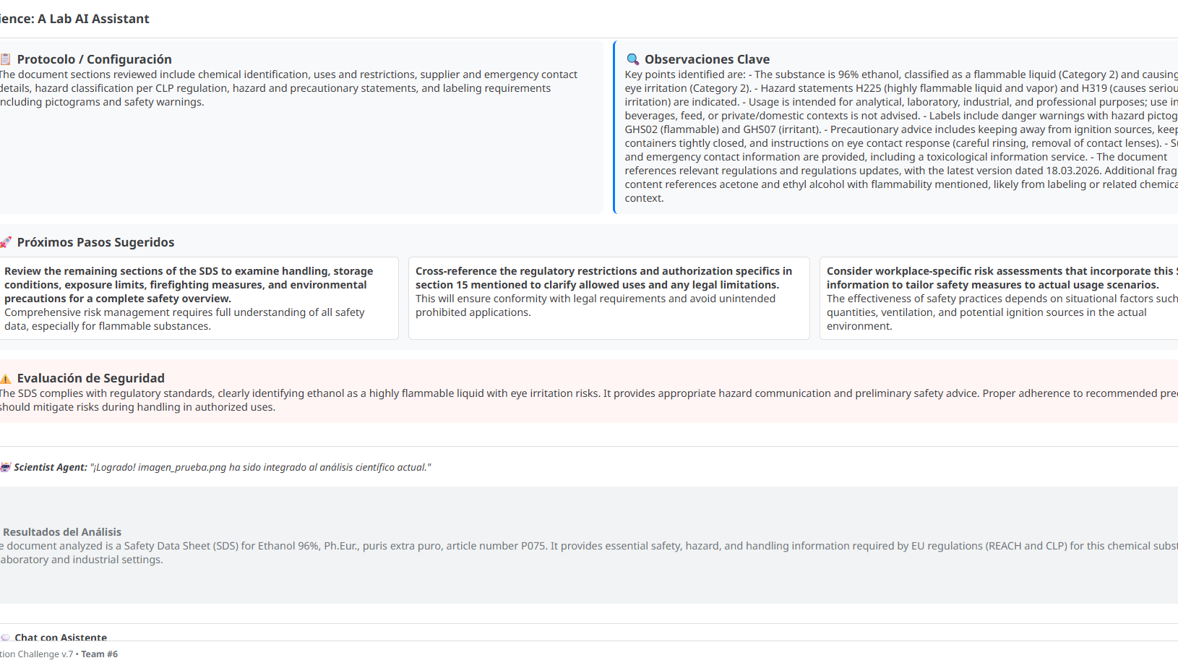
Outputs
Generates structured scientific insights, including protocol analysis and safety assessments

Slide 8
III
System Architecture (The "Durable" Engine)

Slide 9
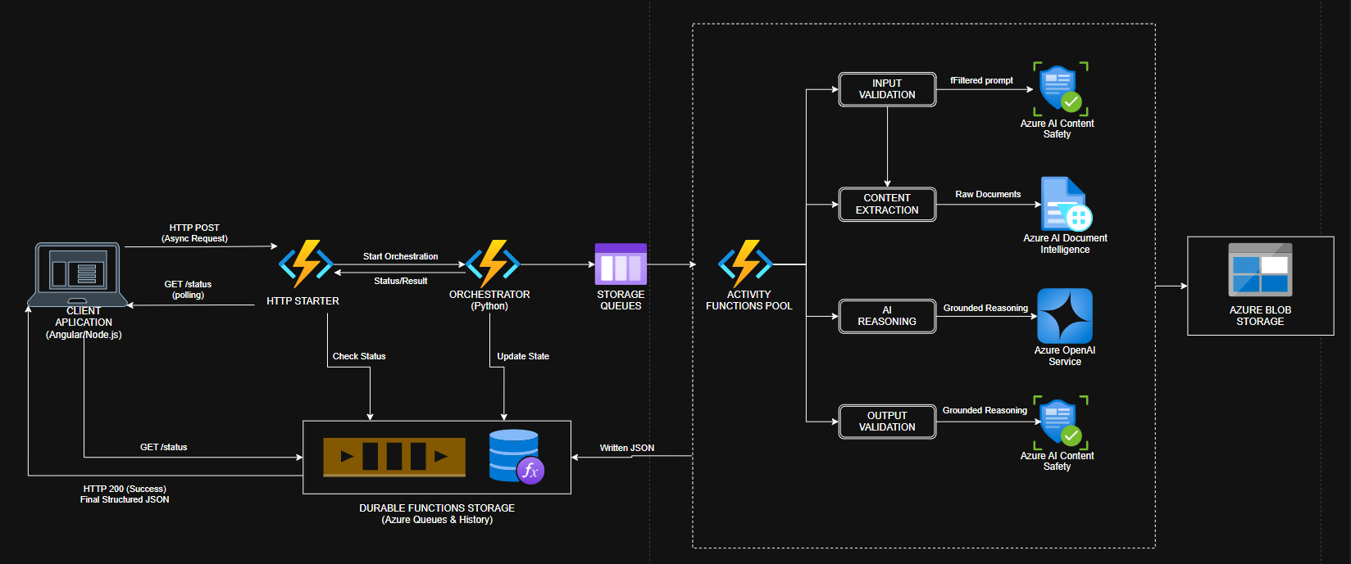

System Architecture
Storage: Secure integration with Azure Blob Storage for file persistence.
Communication: Reliable state management using Storage Queues and Durable Functions Storage.
Asynchronous Processing: Powered by Azure Durable Functions (Python) using an Orchestrator/Activity pattern

Slide 10
IV
The AI Reasoning Layer

Slide 11
The AI Reasoning Layer
Model
Agentic Intelligence
Document Intelligence
Powered by GPT-4.1 Mini via Azure AI Projects for cost-efficient and fast execution.
Uses an Azure AI Agent to generate comprehensive summaries, observations, and logical next steps.
Leverages Azure AI to extract text from complex scientific documents and setup photos.

Slide 12
V
Multi-Layer Safety (The "Golden Record")

Slide 13
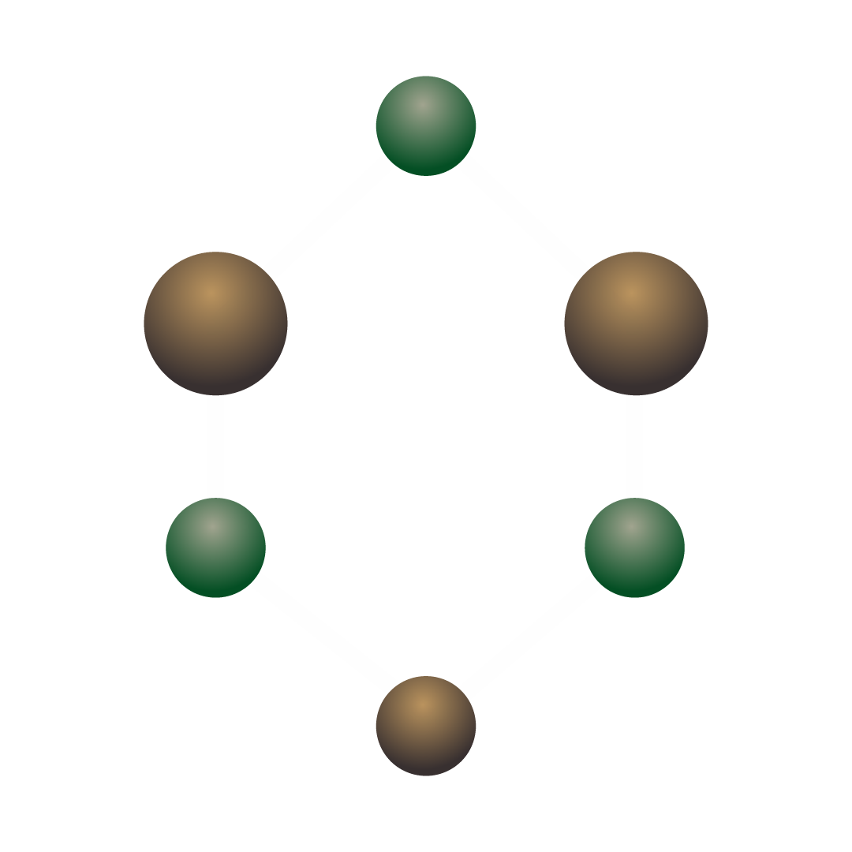
Multi-Layer Safety
Layer 1 (Content Safety)
Layer 2 (Backend Logic)
Input and output moderation via Azure AI Content Safety.
Custom lab safety rules to block hazardous modifications and high-reactivity suggestions.
Layer 3 (Frontend Guard)
UI-level blocking prevents unsafe prompts from ever reaching the backend.

Slide 14
VI
Technical Flow & Design Decisions

Slide 15
Design Decisions
Clean Design
Structured Output
Safe-by-Design
Purposefully removed complex RAG layers and over-engineered orchestration to focus on speed and reliability.
Every response is formatted for UI rendering, ensuring explainability for the researcher.
Validations are performed at every stage of the process, from input validation to final structured JSON output.
Workflow here

Slide 16
VII
Future Roadmap & Summary

Slide 17
Future Roadmap & Summary
Future Improvements
Fine-tuned safety classifiers, advanced uncertainty modeling, and experiment tracking dashboards.
Summary
NextStep Science is a safe, controlled, and explainable lab reasoning system built for the modern laboratory

